Slide 1

SMARTEXAM
Expanding GovTech's Build on BoB into the EdTech Market
An AI-powered exam generation and validation platform, built on BoB's rapid workflow engine.

Slide 2


THE
EDUCATIONAL ASSESSMENT GAP
For Students & Parents: The removal of mid-year exams has created an "Assessment Gap." This leads to high anxiety, reliance on expensive mock exams (up to $130 per session), and no clear benchmark for progress.
For Educational Institutions: Creating high-quality, secure, and consistent exam papers is slow and resource-intensive. There is no standardized, efficient workflow for teachers to create, review, and approve assessment materials.
This is a workflow and validation problem, perfect for a BoB-powered solution.

Slide 3


OUR SOLUTION
SMARTEXAM
POWERED BY
SMARTEXAM is an on-demand platform that leverages BoB to allow educational institutions to instantly generate, securely review, and efficiently manage exam papers.
For Educators
(The Configurators): Instantly create curriculum-aligned exams using AI via a simple BoB form.
Drastically reduces preparation time.
For a School's Exam Committee
(The Back-Office Users):
Use BoB's role-based workflow to review, edit, and approve papers, ensuring quality and consistency.
A secure, auditable approval chain.
For Students
(The End-Users):
Access affordable, high-quality practice papers to bridge the assessment gap and reduce anxiety.
Builds confidence and readiness.

Slide 4
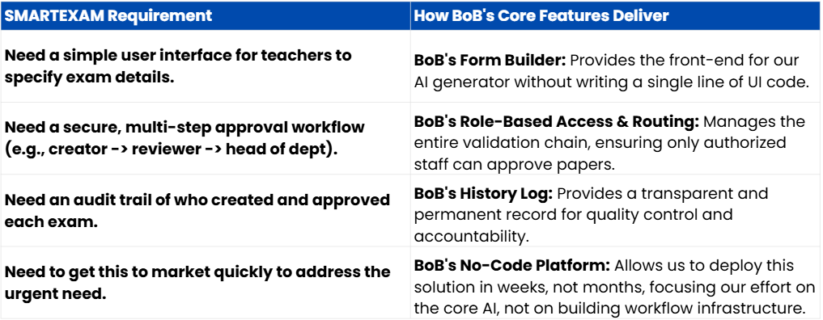
THE
ADVANTAGE
SPEED, TRUST, AND CONFIGURABILITY

Slide 5

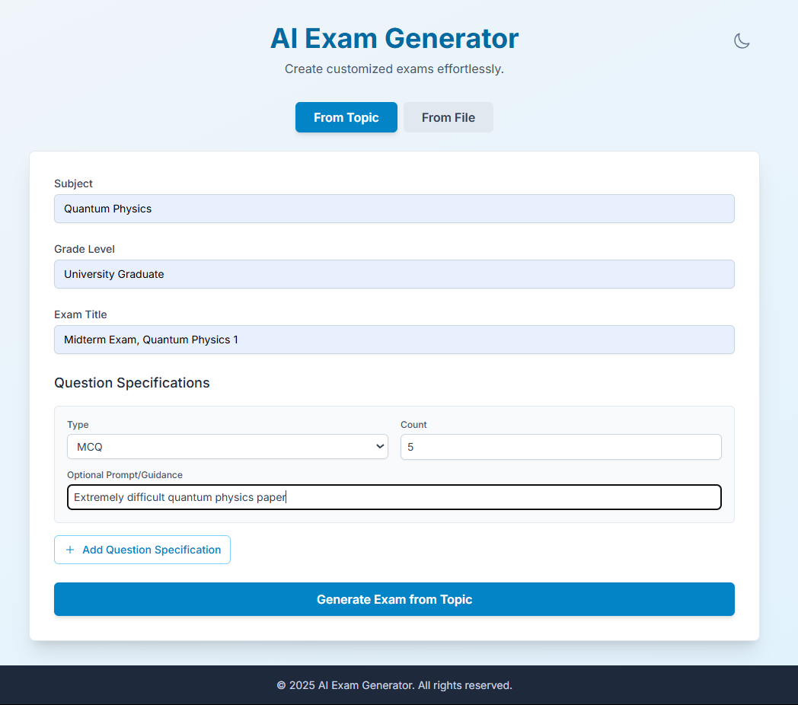
SMARTEXAM IN ACTION
A 3-STEP WORKFLOW
1
GENERATE
A teacher (The Configurator) uses a simple BoB form to define exam parameters like subject and question types, or simply uploads their own syllabus. The AI instantly generates a draft.

Slide 6
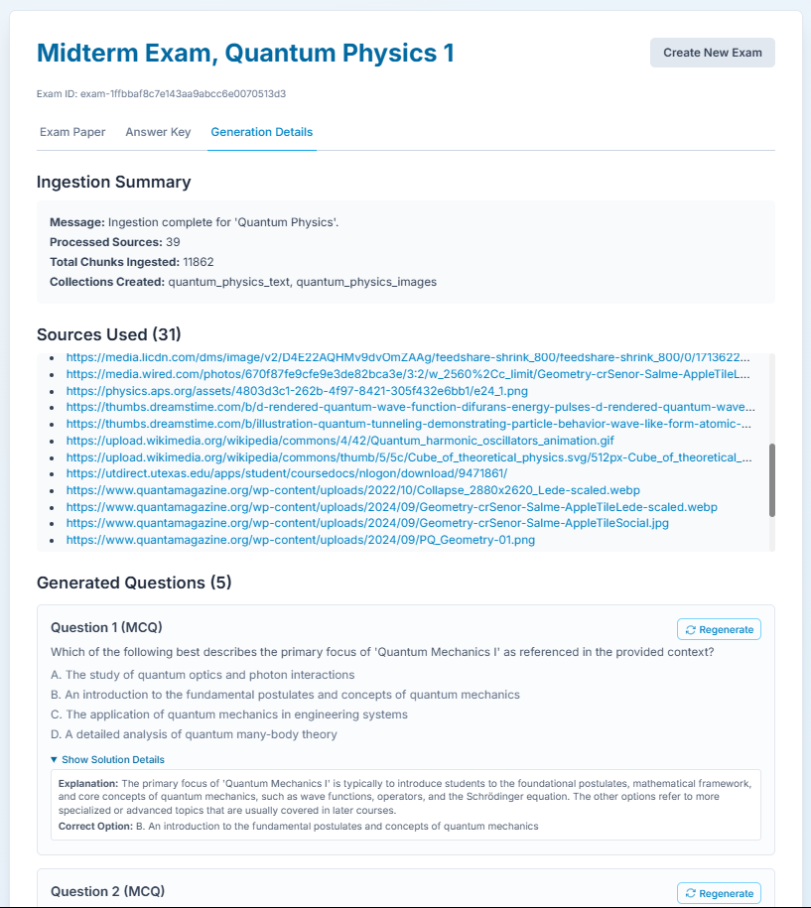
SMARTEXAM IN ACTION
A 3-STEP WORKFLOW
2
VALIDATE
The draft is automatically routed via BoB's workflow to the Exam Committee (The Back-Office Users). They review the AI's sources, check for quality, and can regenerate questions before approval.

Slide 7
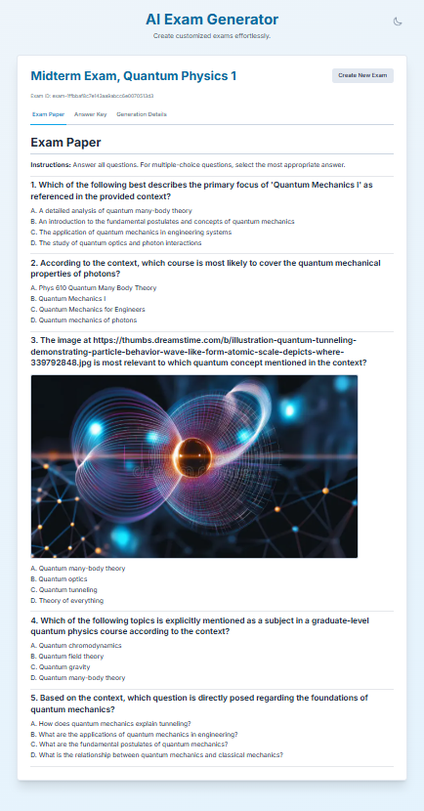
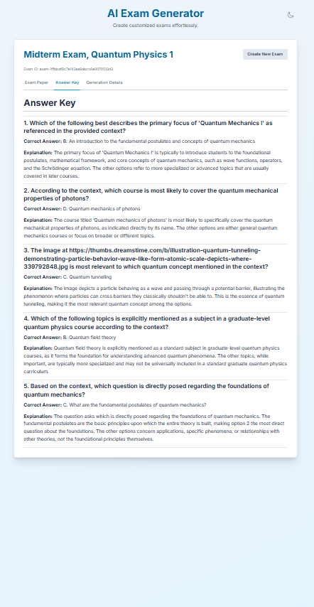
SMARTEXAM IN ACTION
A 3-STEP WORKFLOW
3
DELIVER
Once approved, the final Question Paper and Answer Key are generated and securely stored in the organization's library, ready for distribution and use.

Slide 8
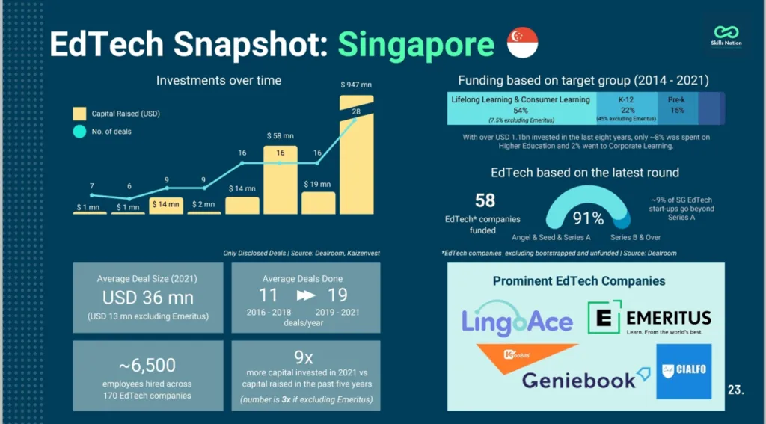
TAPPING INTO SINGAPORE'S
MARKET SIZE
US$2.2 Billion by 2027.
Only ~8% of EdTech funding goes to Higher Education, and even less to internal tooling for K-12. This is our underserved niche.
US$2.2B EDTECH MARKET
GO-TO-MARKET (GTM) STRATEGY
Target Customers:
Phase 1: Private Tuition & Enrichment Centres (e.g., The Learning Lab, MindStretcher) - They need to innovate and offer value to compete.
Phase 2: Institutes of Higher Learning (IHLs) & Private Education Institutions.
Pilot Program: Launch a pilot program with 2-3 mid-sized tuition centres to validate the product and gather testimonials.
Pricing Model: Tiered Hybrid SaaS. We offer a monthly subscription with a generous allowance of generated exams. This provides budget predictability for schools and aligns price with value. Overage is handled on a simple pay-per-exam basis.

Slide 9

























TECHNICALLY FEASIBLE ARCHITECTURE
Organization Request Verification
Exam Committee for School
Submits Generation Request
User Role 1
User Role 2
Request Approved
Generated Document Verification / Regeneration
Receives Generated Paper
Organization with BoB Access
Organization Paper Library Access
Frontend with BoB Form Integration
Our modular architecture cleanly separates concerns: BoB handles the user-facing forms and approval workflows, while our backend focuses on the core AI generation. This ensures robustness and speed to market.
Retrieval using APIs
Frontend & Backend Communication
Vector Database for
Ingestion / Retrieval
Unstructured for
Formatting
Organization Resources (For generation to cater to organization needs)
Agent to Agent Protocol
Question Generator
Math Solver
Report Compiler
GPT Web Query Agent
Web Searching / Open Resources
General Solver
Google Programmable
Search JSON API
Obtain Data
Backend workflow with data processing + structured report generation

Slide 10

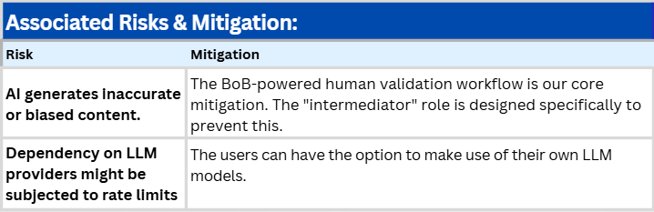
MEASURING
SUCCESS
AND
FUTURE GROWTH
Roadmap / Future Enhancements:
Success Metrics (Product Monitoring):
Adoption: Number of active educational institutions. (Goal: 10 pilot centers in Year 1).
Value: Average time saved per teacher in exam preparation (measured via user surveys).
Integration with school learning management systems (LMS).
Q1
Usage: Number of exams generated per week. (Goal: 1,000 exams/month by end of Y1).
North Star Metric: % of generated exams approved without modification (a proxy for AI quality).
AI-powered performance analytics for students.
Q2
Expansion to corporate training and certification programs (a new market expansion for BoB!).
Q3

Slide 11


THANK YOU
REFERENCES
CJ.my – Geniebook expansio (2021, October). Geniebook expand in Vietnam to foster 1 million changemakers. Retrieved July 2, 2025, from https://cj.my/124522/geniebook-expand-in-vietnam-to-foster-1-million-changemakers/
Elangovan, N. (2023, June 16). Hundreds sign up for tuition centre mock exams costing up to S$130, after scrapping of all mid‑year school exams. TODAY. Retrieved July 4, 2025, from https://www.todayonline.com/singapore/hundreds-sign-mock-exam-tuition-centre-scrapping-mid-year-school-exams-2194586
Singapore EdTech Market – MarketResearchSingapore. (n.d.). Singapore EdTech market: Opportunities & growth outlook. Retrieved July 2, 2025, from Singapore EdTech Market: Opportunities & Growth Outlook website: https://marketresearchsingapore.com/insights/articles/singapore-edtech-market-opportunities-learning-future
With Content (Content Marketing Agency) (2024). EdTech Singapore. Retrieved July 2, 2025, from Edtech Singapore website: https://withcontent.co/edtech-singapore/
SEE OUR PROJECT
https://github.com/Rah-Rah-Mitra/SmartExam

